Slide 1
Introduction into SQLAlchemy
How SQLAlchemy is helping developers to boost productivity while building DB based applications
By Vlad Vladymyrov
Senior Software Engineer/Consultant at Ericsson

Slide 2
Why DB toolkit/ORM?
Naïve DB application development cycle
Create database schema – tables, indices, constraints
Develop insert and update statements
Develop select queries
Develop store/load code that uses the queries
What if the requirements were changed and developer needs to update database schema
He/she also needs to update code and sql statements
What if the customer asked to port the application to another Database System?

Slide 3
SQLAlchemy
Data base toolkit and Object Relation Mapper
Written on pure Python (>=2.5, 3.x, Jython, PyPy)
MIT license
Current version: 0.8.1 (started in 2005)
Author: Michael Bayer:http://zzzeek.org/
Official site: http://www.sqlalchemy.org

Slide 4






Users
Many more http://bit.ly/myNgQR

Slide 5
SQLAlchemy Philosophy
Provides a consistent interface to different databases and DB API adapters: (SQLite, PostgreSQL, MySQL, MSSQL, Oracle, Sybase, Firebird, more)
Still exposes distinct behaviors and features of each backend
Brings database to the developer’s finger tips: must think in SQL and relation algebra
Provides automation and DRY

Slide 6
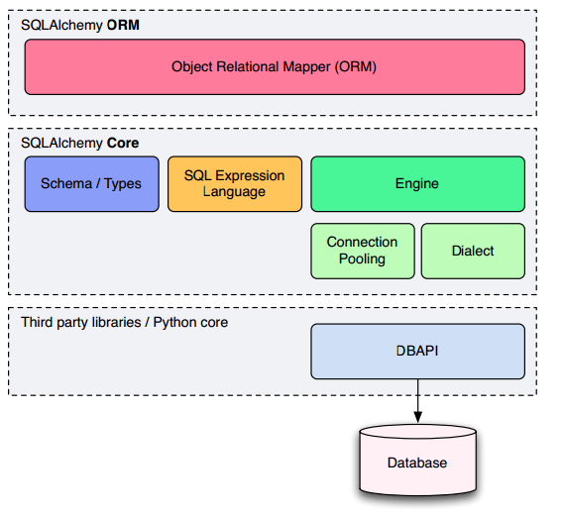
Architecture Overview

Slide 7
Automation and DRY
Everything is a Python object
Code your DB, schema definition and queries in Python
Allows to use composition patterns:
Table joins, selects and other statements can be composed together into the new statements
Database agnostic
Write the schema and queries once
Use them on multiple DB systems
If you have an existing database schema
SQLAlchemy has reflection feature

Slide 8
How to start learning SQLAlchemy
Introduction to SQLAlchemy. Mike Bayer talk at Pycon 2013: http://bit.ly/ZdWNQs
2.5h video lecture available plus Source code examples
Pycon 2012: Hand Coded Applications with SQLAlchemy - http://bit.ly/18gZPqI
Pycon Canada 2012 – the SQLAlchemy Session in Depth http://bit.ly/S1FRF8

Slide 9
Where to look for help
Documentation on http://www.sqlalchemy.org
[sqlalchemy] tag on http://stackoverflow.com
http://www.sqlalchemy.org/support.html
Mailing List on Google Groups
IRC channel
Source code: available on github.com and bitbucket.com

Slide 10
Questions?

Slide 11
Shameless plug
I’m currently looking for new position as a software engineer
Please contact me via email:
smartkiwi@gmail.com

